Slide 1

Automated Entrance Authorization System
Presented By:
Hamza Zahid
Hassaan Waseem
Rai Shahnawaz Khan

Slide 2
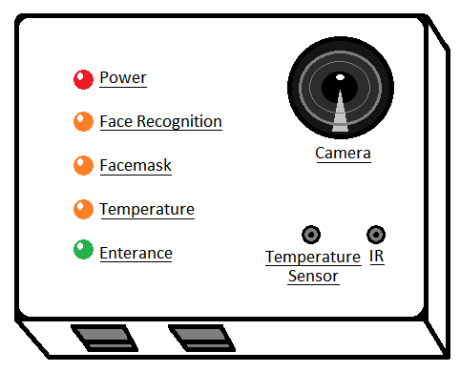
Introduction:
It is an Automated Entrance System which performs:
Facial Recognition
Mask Detection
Contactless body temperature measurement
Access is granted after passing these checks successfully.

Slide 3
Objectives:
The main objective of the project are as follows:
Contactless entry
Reduces man power
Increases Security

Slide 4
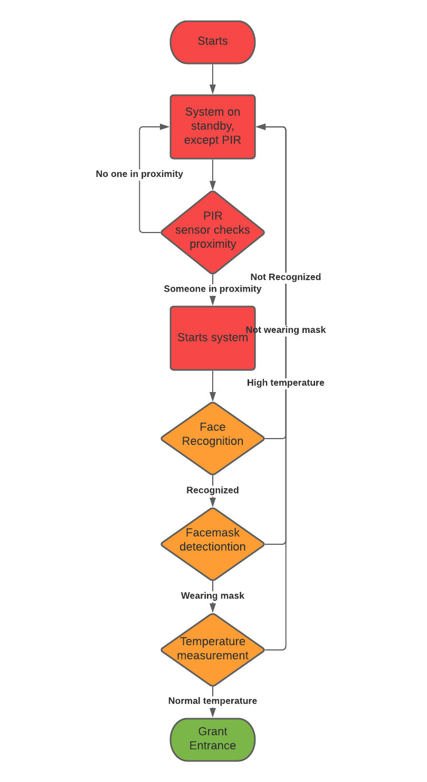
Flowchart:

Slide 5

Screens:

Slide 6
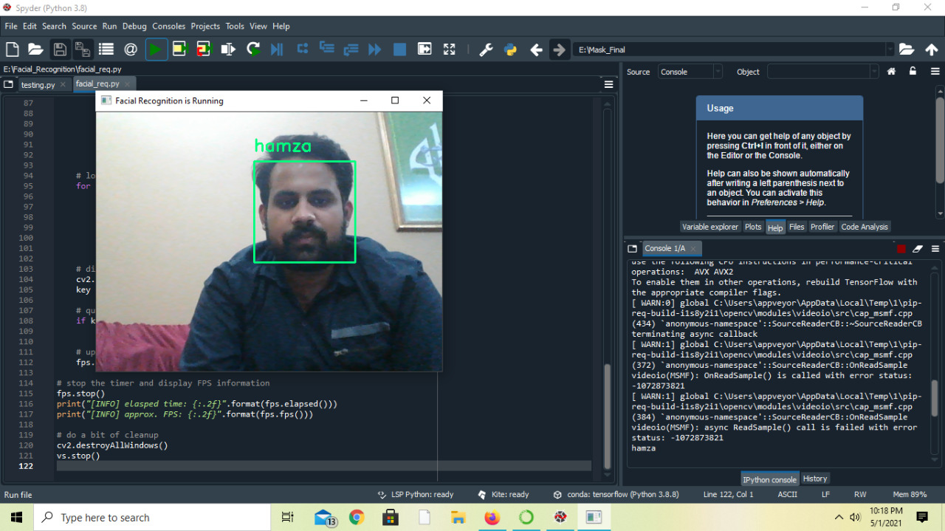
Screens:
Facial Recognition

Slide 7
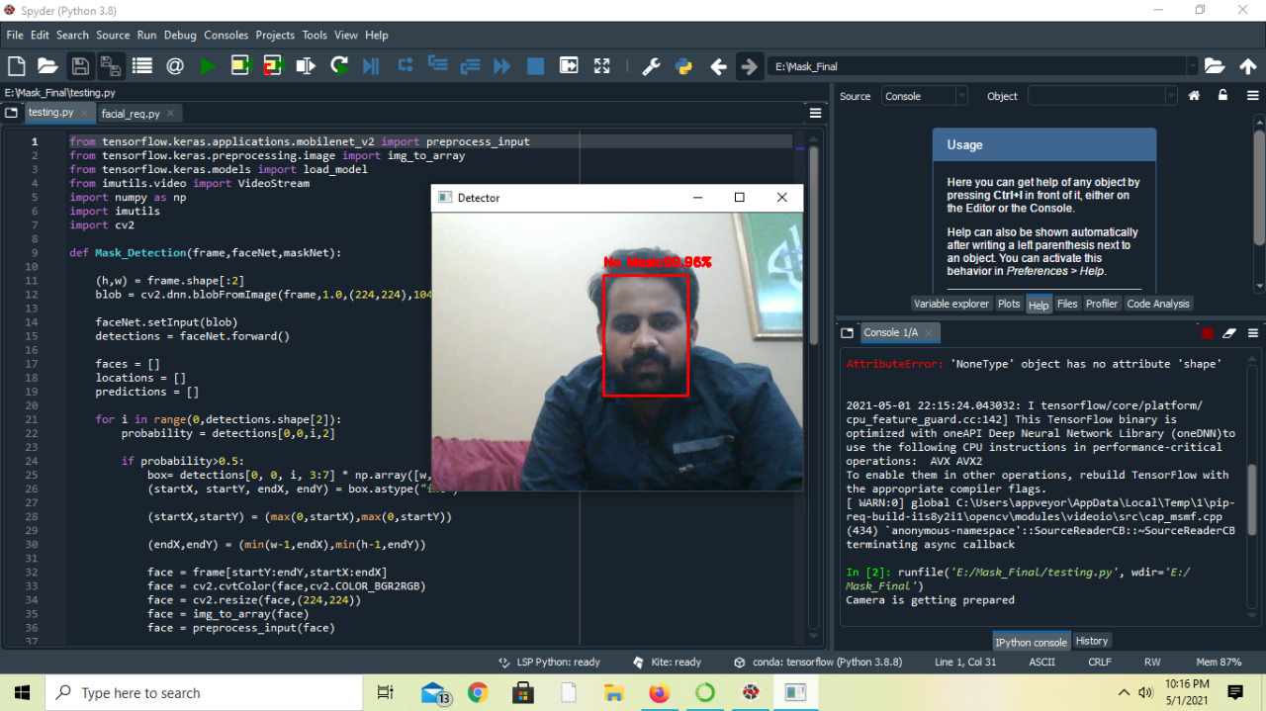
Screens:
Facemask Detection

Slide 8
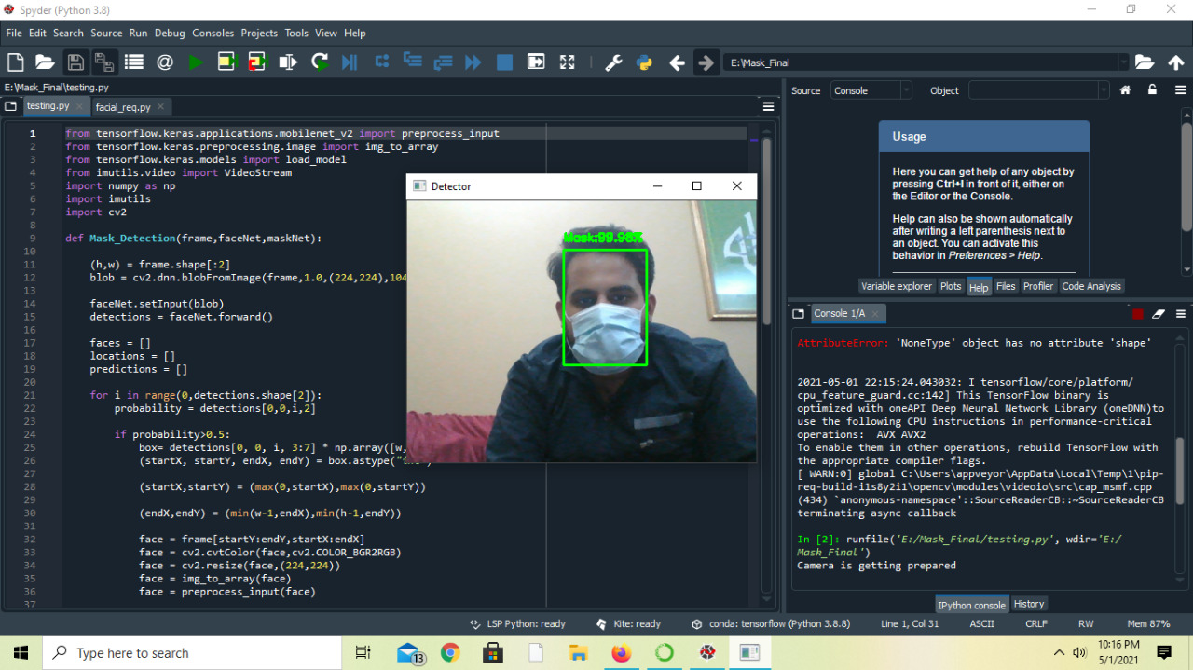
Screens:
Facemask Detection

Slide 9
Design and Implementation:
It is a hardware embedded system built on Raspberry Pi 4.
All the scripts are written in Python.
Neural Networks such as CNN & DNN
and different classifiers such as Haar Cascade
It is using different libraries like Tensorflow, OpenCV, Numpy, matplotlib, imutils, Keras and Adafruit modules.

Slide 10
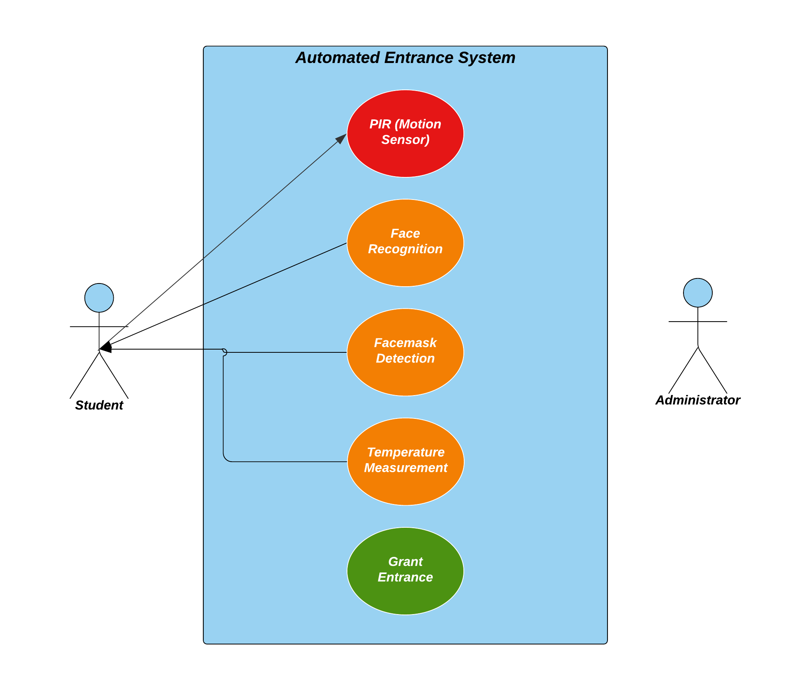
Application and Data Architecture:
Motion Detection
Mask Detection
Face Recognition
Temperature Measurement
Grant Entrance
This process is running continuously.

Slide 11
Challenges:
It is a huge project. It was a difficult task to learn and implement.
No prior knowledge of libraries
Communication Gap.
Limited Budget and Limited Resources

Slide 12
THANK YOU
“By Love Serve One Another.”

